Slide 1
TEST 5
Civil War - Reconstruction

Slide 2
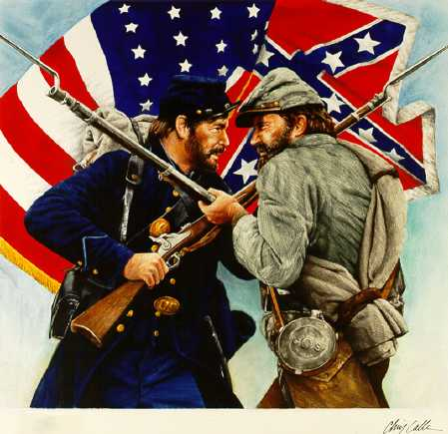

Slide 3
Causes of the Civil War
State’s Rights
Slavery
Sectionalism
Differing Economies and views on Tariffs
Southerners Believe “state first and their country second”
Lincoln was committed to preserving the Union(country)

Slide 4
Sectionalism

Slide 5
The War begins
1860- Lincoln Elected
SC and other southern states secede
C.S.A. is formed
Jefferson Davis is elected President of the C.S.A.
Confederate forces attack Fort Sumter (occupied by U.S. Forces)
The Civil War had become a military conflict

Slide 6
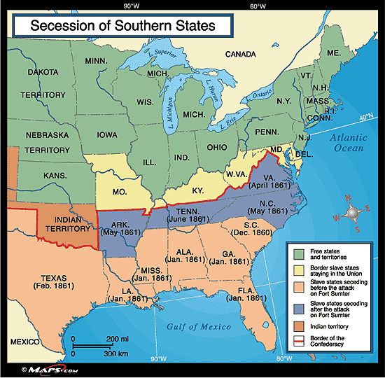

Slide 7
Legends of the Civil War
Union (North)
Confederacy (South)
Abraham Lincoln
President
Winfield Scott, George McClellan, Ulysses S. Grant
Commander of Union Forces
William T. Sherman
General
Jefferson Davis
President
Robert E. Lee
Commander of Confederate Troops
Thomas “Stonewall” Jackson
General

Slide 8
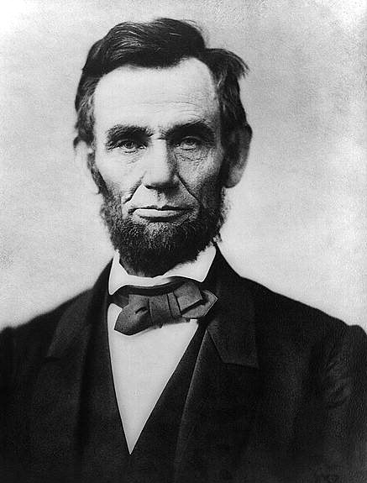
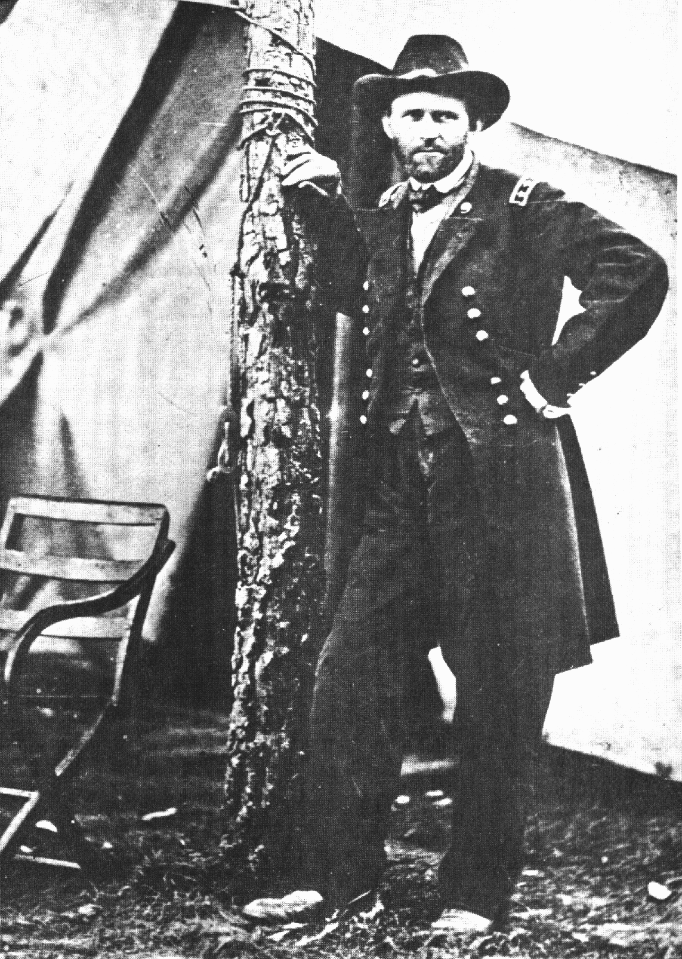
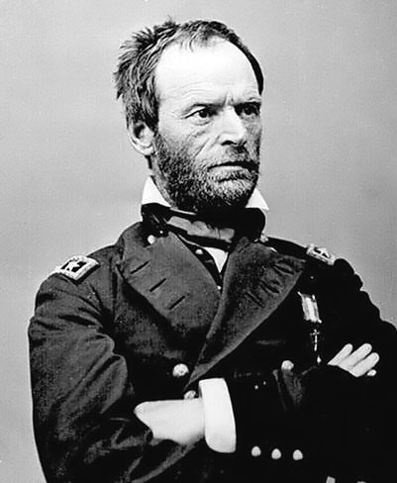
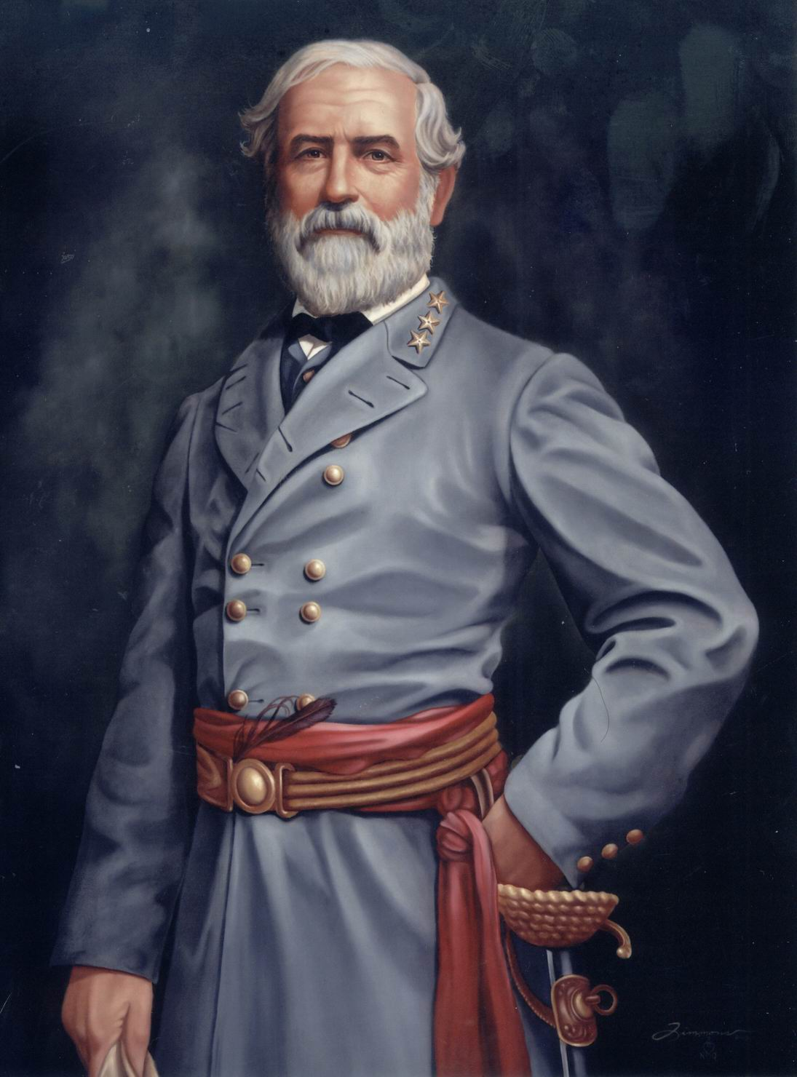
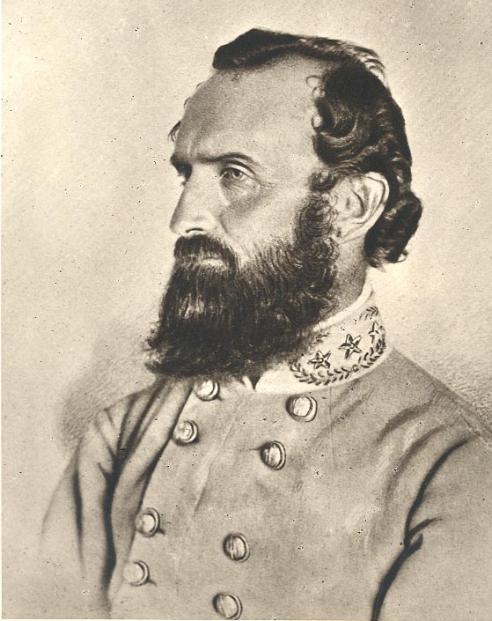
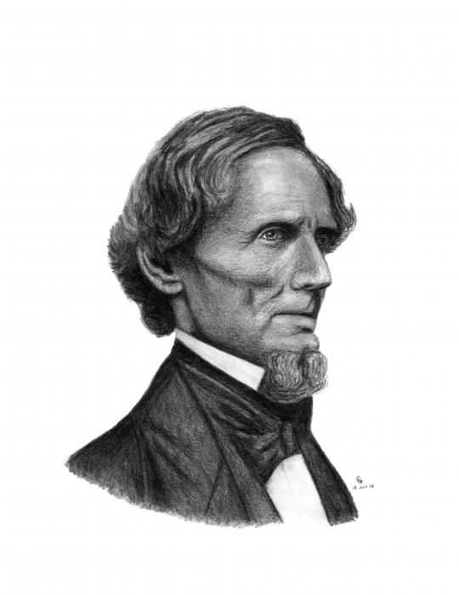

Slide 9
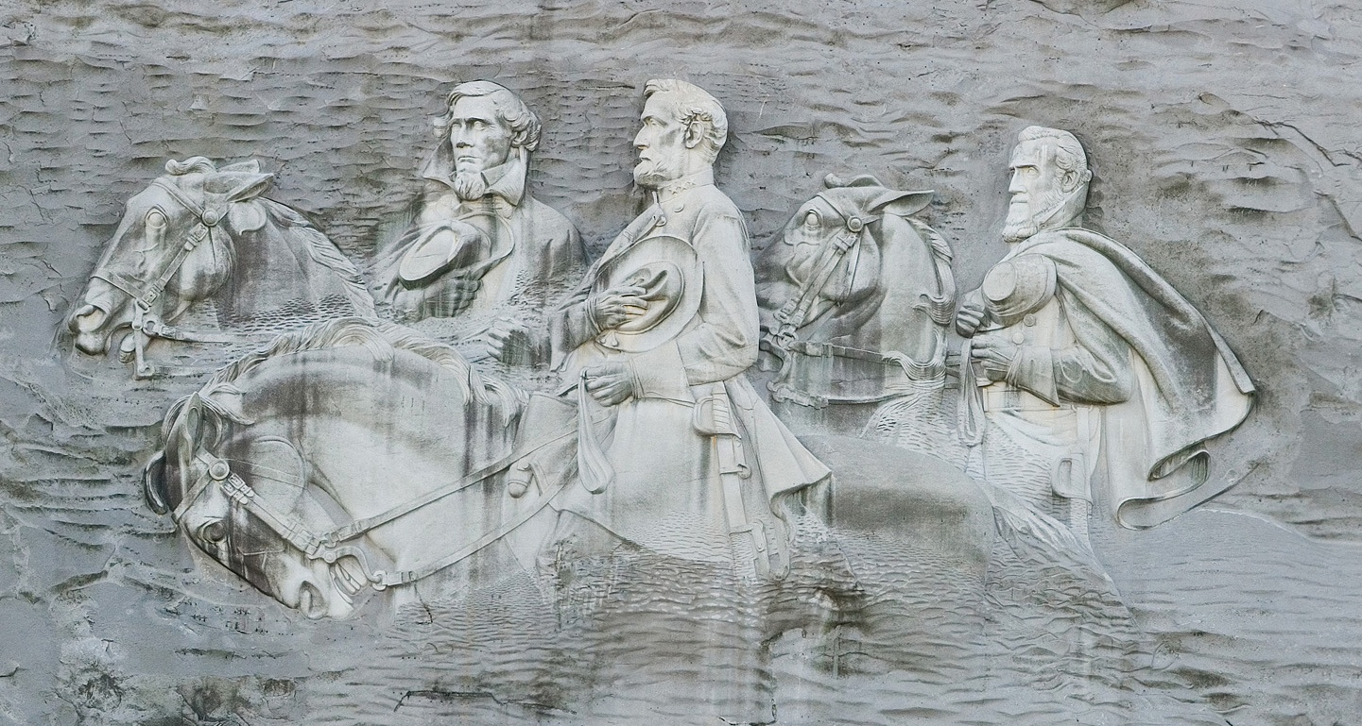
Stone Mountain

Slide 10
Major Battles
Fort Sumter: April, 1861 (South wins)
1st Battle of the Civil War
Confederates fire on Union Forces
Lincoln is forced to take action against the South
Antietam: September, 1862 (Tie)
1st Major battle on northern soil
26,000 total casualties
Vicksburg: May-July, 1863 (North Wins)
Grant attack Confederate forces attempting to take control of the Mississippi River (part of the Anaconda Plan)
Union victory cut off supplies to southern states/troops

Slide 11
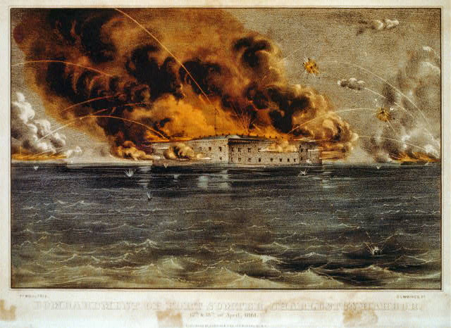

Slide 12
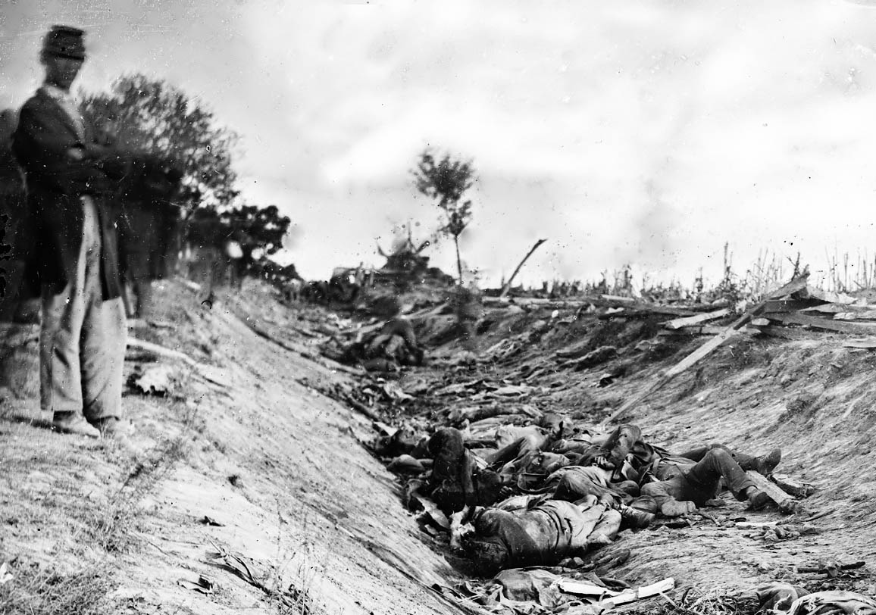

Slide 13
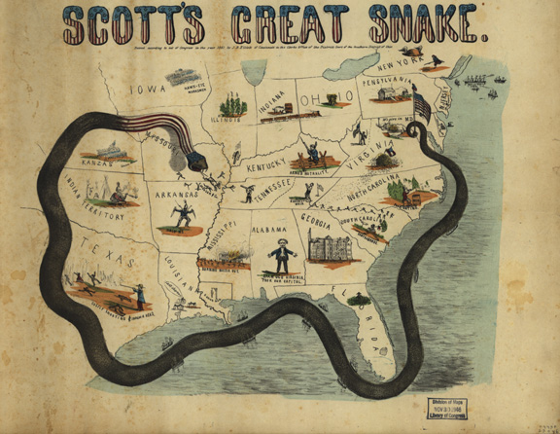

Slide 14
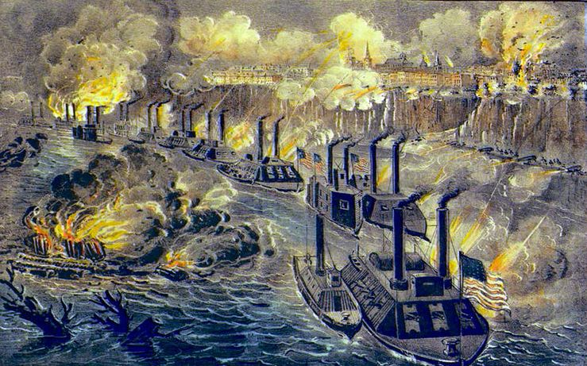

Slide 15
Major Battles
Gettysburg: July, 1863 (North Wins)
3 Day Battle, 50,000 +++ killed
Deadliest battle of the American Civil War
Lee gave up attempts to invade the Union
Atlanta: July-September, 1864 (North Wins)
Atlanta was the center of Confederate manufacturing and railway traffic
Sherman’s March to the Sea destroys EVERYTHING between ATL and Savannah
Appomattox Court House: April 9, 1865
General Lee Surrenders

Slide 16
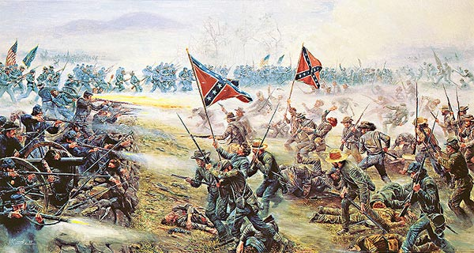

Slide 18
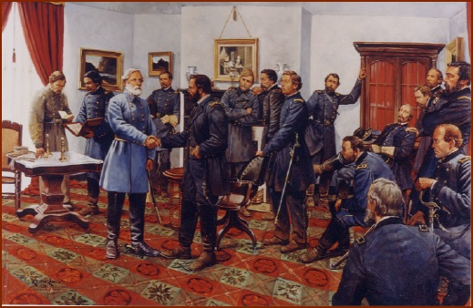

Slide 19
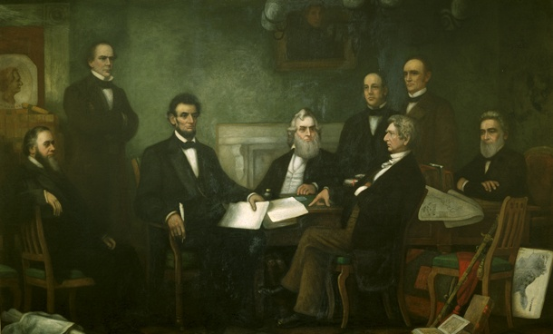
Emancipation Proclamation
January 1, 1863
Emancipated (freed) all slaves held in the Confederate states
Officially made the war about ending slavery
13th Amendment
Frees the slaves

Slide 20
Habeas Corpus
April 27, 1861
Lincoln suspended the constitutional right of habeas corpus
the legal rule that anyone imprisoned must be taken before a judge to determine guilt/innocence if the prisoner is being legally held in custody
Constitution allows a president to suspend habeas corpus during a national emergency
13,000 Confederate sympathizers were arrested in the North without trial

Slide 21
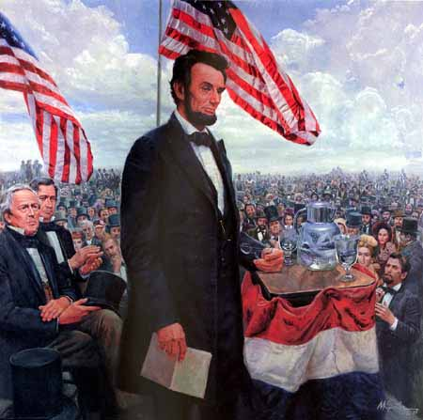
Gettysburg Address
November 16, 1863
dedication of a military cemetery at the Gettysburg battlefield four months after the battle occurred
Speech about our great country and how we needed to finish the war
Americans respond jubilantly across the country

Slide 22
Gettysburg Questions
For what causes did Lincoln believe the soldiers were fighting in the Civil War?
Count how often Lincoln uses the word "nation" in his Gettysburg Address. Why do you think he uses "nation" repeatedly, and not the word "union" at all? What might "nation" suggest or make clear that "union" does not?
Lincoln never mentions slavery in his Gettysburg Address. Why not? How is it implied in his dedicatory remarks?

Slide 23
Lincoln’s Second Inaugural Address
March 4, 1865
Lincoln speaks to the nation about the war and putting the country back together in his 2nd term
Lincoln expressed sorrow that the states had not been able to resolve their differences peacefully
Urged Americans not to seek revenge on slaveholders and their supporters/military
Addressed the major issues in the country at the time

Slide 24
What if you were President…
Lincoln’s 2nd Inaugural address let people know what he thought about everything going on in the country.
If you were elected president today, what are the three main issues that you would want to change about America starting tomorrow?
In a primetime television event, what would you want to tell Americans?

Slide 25
Assassination
John Wilkes Booth Kills Abraham Lincoln in the Ford Theatre
Lincoln is succeeded by Andrew Johnson
Johnson carries on Lincoln's plans for Reconstruction

Slide 26
President Andrew Johnson's Plan (Presidential Reconstruction)
Lincoln’s 10% Plan
To reenter the Union, states had to: - swear allegiance to the Union - ratify the 13th amendment
Was willing to pardon high-ranking Confederate officers
Favored states' rights on issues such as giving African Americans the right to vote
Did not support the Freedman's Bureau
Took a conciliatory approach

Slide 27
Radical Republicans' Plan (Congress)
Supported the Freedman's Bureau - Created schools - Created hospitals - Created Industrial Institutes - Created teacher-training centers - Distributed food and clothing
Supported Civil Rights Act of 1866, which outlawed Black Codes
Passage of 13th, 14th, and 15th amendments required to reenter Union
Divided the South into five military districts
Supported equal rights for African Americans
Land redistribution: “40 Acres and a mule”

Slide 28
Reconstruction Legislation
13th Amendment: Freed slaves
14th Amendment: Gave freed slaves citizenship
15th Amendment: Guaranteed voting rights
Freedmen’s Bureau Acts: Offered assistance to freed slaves; food, clothing, work, land healthcare
Civil Rights Act of 1866: granted equal protection under the law to African Americans
Reconstruction Act of 1867: abolished confederate governments and divided the south into 5 military districts; also set up strict requirements for reentering the Union
Enforcement Act of 1870: Gave the federal gov’t power to enforce the 15th Amendment

Slide 29
Opposition to Reconstruction Efforts
Not all white Southerners accepted the equal status of former slaves.
Birth of the KKK
Founded by veterans of the Confederate Army to fight against Reconstruction
White supremacy organization (terrorists)
Black Codes
Laws written to control the lives of freed slaves in ways slaveholders had formerly controlled the lives of their slaves
Black Codes deprived voting rights to freed slaves and allowed plantation owners to take advantage of black workers in ways that made it seem that slavery had not been abolished.

Slide 30
Impeachment of Johnson
During the Reconstruction period, the biggest issue in northern and southern states alike was the impeachment of President Andrew Johnson.
U.S. Constitution allows Congress to remove the president from office by impeaching (accusing) him of committing “high crimes and misdemeanors,” so Radical Republicans impeached Johnson when he ignored laws they had passed to limit presidential powers.
They passed these laws to stop Johnson from curbing the Radical Republicans’ hostile treatment of former Confederate states and their leaders.
After a three-month trial in the Senate, Johnson missed being convicted by one vote, so he was not removed from office merely because he held political opinions unpopular among politicians who had the power to impeach him.

