Slide 1
Test #11
Civil Rights
Vietnam War

Slide 3
LBJ’s Great Society
President Johnson wanted to give all Americans a “better” standard of living and greater opportunities regardless of their background
Improve elementary and secondary education, to protect the environment, and to reform immigration policies
Medicare
The Gov’t provides healthcare insurance and benefits for citizens over the age of 65

Slide 4
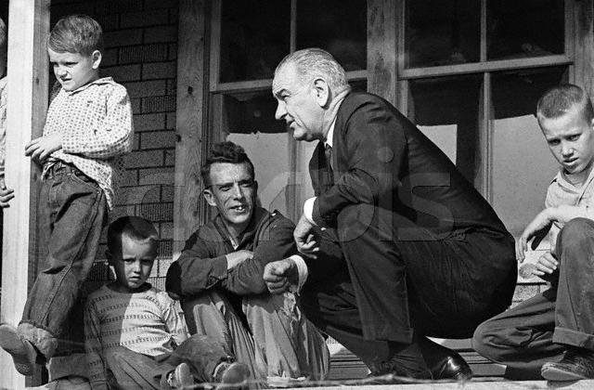

Slide 5
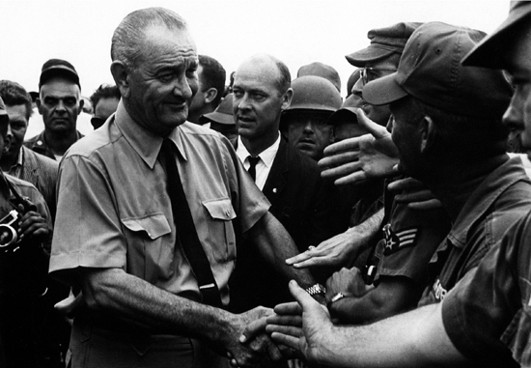

Slide 6
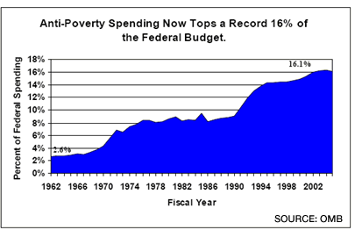

Slide 7
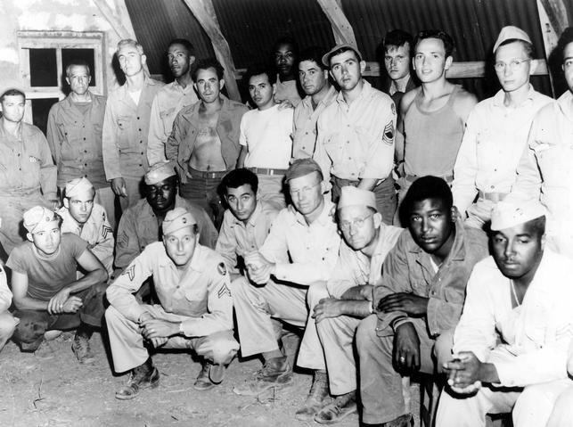
Civil Rights Movement
Truman integrates the military and ends discrimination in hiring of federal employees
TV news coverage of the civil rights movement helped many Americans turn their sympathies toward ending racial segregation

Slide 8
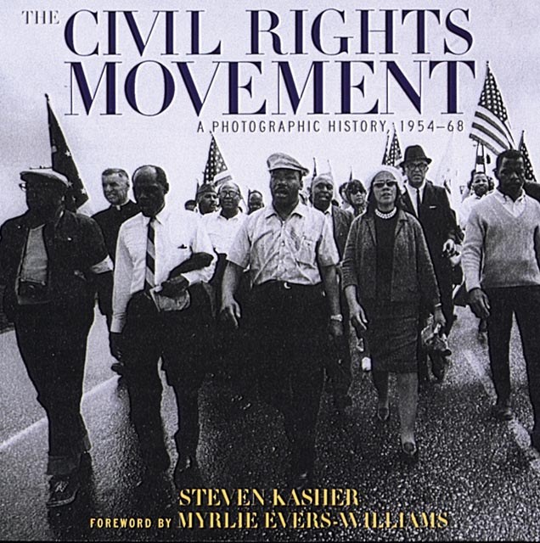

Slide 9
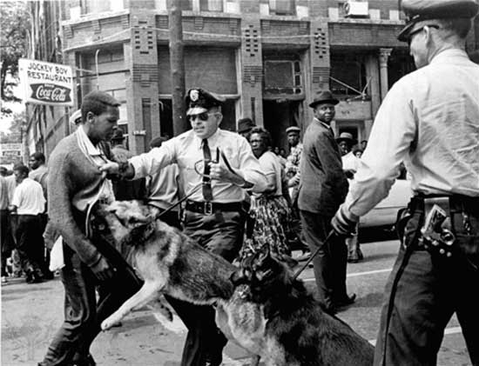

Slide 10
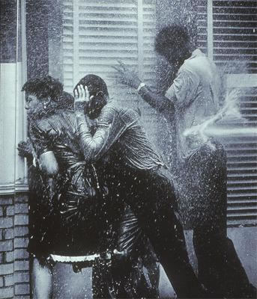

Slide 11
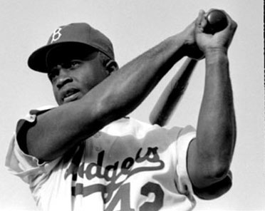
Civil Rights Movement
Jackie Robinson becomes the first black baseball player in the Major League.
He played for the Brooklyn Dodgers and was the league MVP in 1949.

Slide 12
Civil Rights Movement
Brown v Board of Education
U.S. Supreme Court declared that state laws establishing “separate but equal” public schools denied African American students the equal education promised in the Fourteenth Amendment
Overturns Plessy v Ferguson
Violence erupts in Little Rock AK, as troops are used to enforce The Court’s Decision

Slide 13
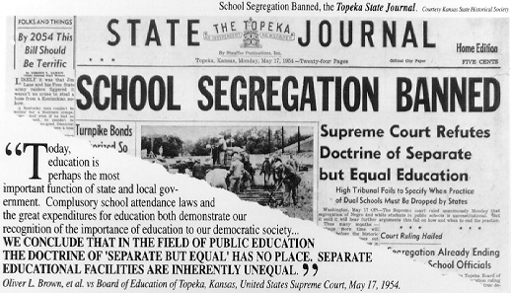

Slide 14
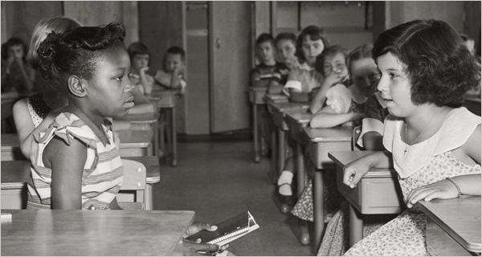

Slide 15
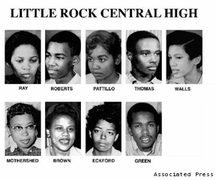
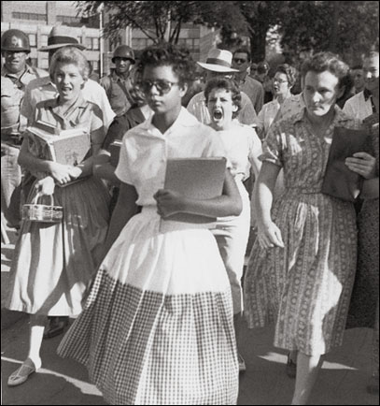
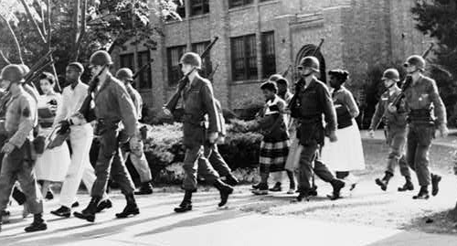
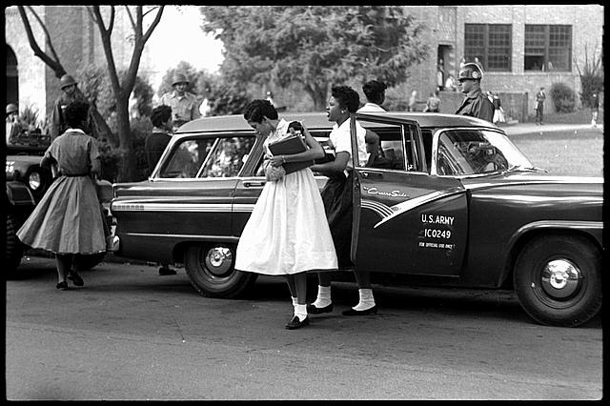

Slide 16
Civil Rights Movement
MLK Jr
Non violent resistance, Civil Disobedience
“Letter from a Birmingham Jail”
White Religious leaders need to help in the Civil Rights Movement
“I Have A Dream”
250,000 people at the Lincoln Memorial listen as King calls for peace and racial harmony in America

Slide 17
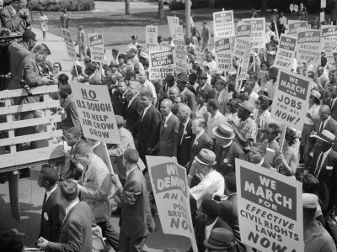

Slide 18
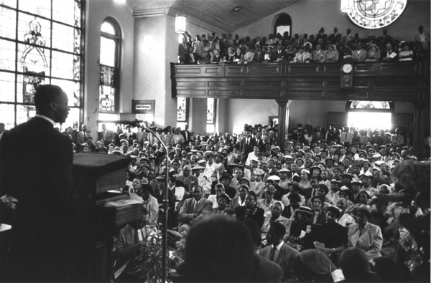

Slide 19
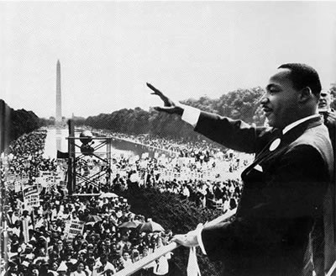

Slide 20
Civil Rights Movement
Civil Rights Act of 1964
prohibited all discrimination based on race, religion, national origin, and gender
allowed all citizens the right to enter any park, restroom, library, theater, and public building in the United States
Voting Rights Act of 1965
outlawed the requirement for would-be voters in the United States to take literacy tests to register to vote, because this requirement was judged as unfair to minorities
Civil Rights Act of 1968
Prevented discrimination in housing

Slide 21
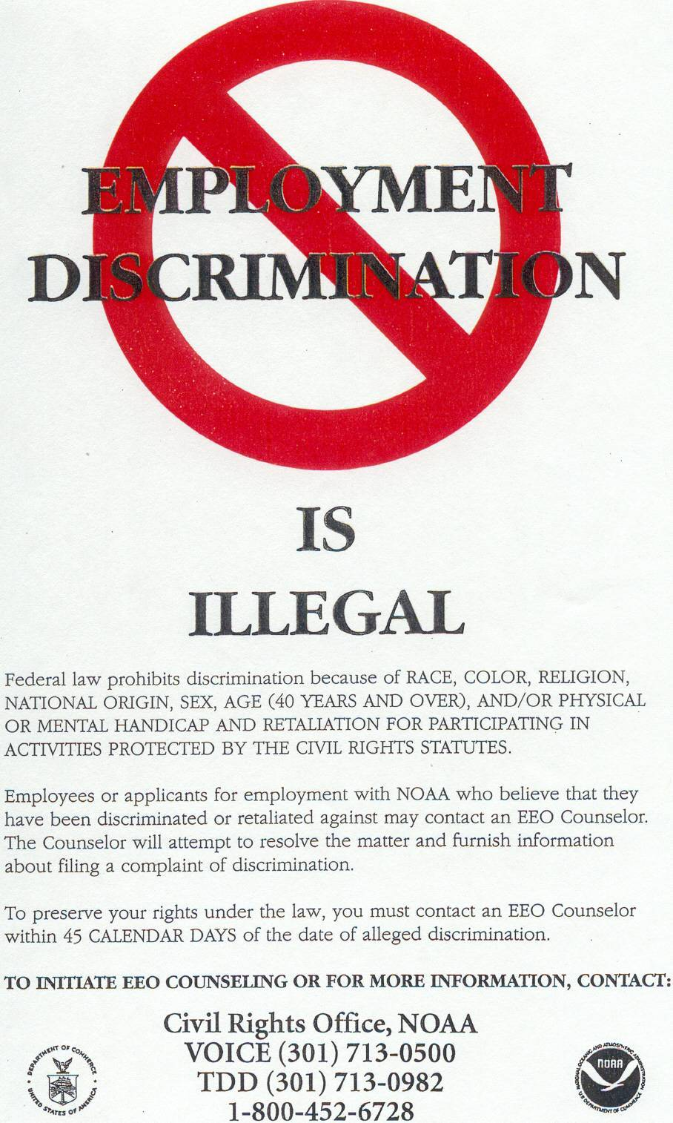
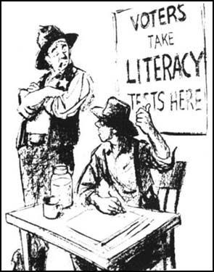

Slide 22
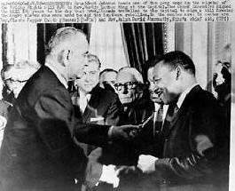
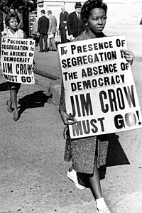
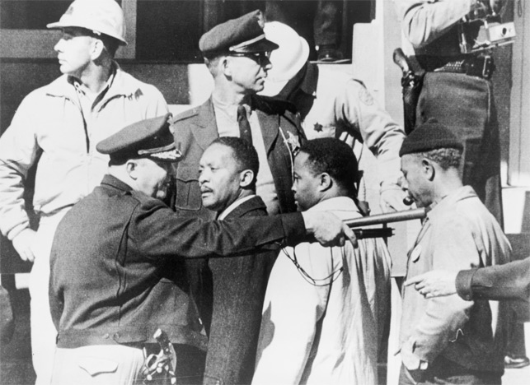

Slide 23
Civil Rights Movement
Warren Court (1950s and 1960s, the U.S. Supreme Court was headed by Chief Justice Earl Warren)
Brown v Board
segregation in public schools was unconstitutional
Constitution includes the right to privacy
right of free speech protects students who wear armbands as an antiwar protest on school grounds
all states must obey all decisions of the Supreme Court
Miranda v Arizona
Police must inform suspects of their constitutional rights at the time of arrest

Slide 24
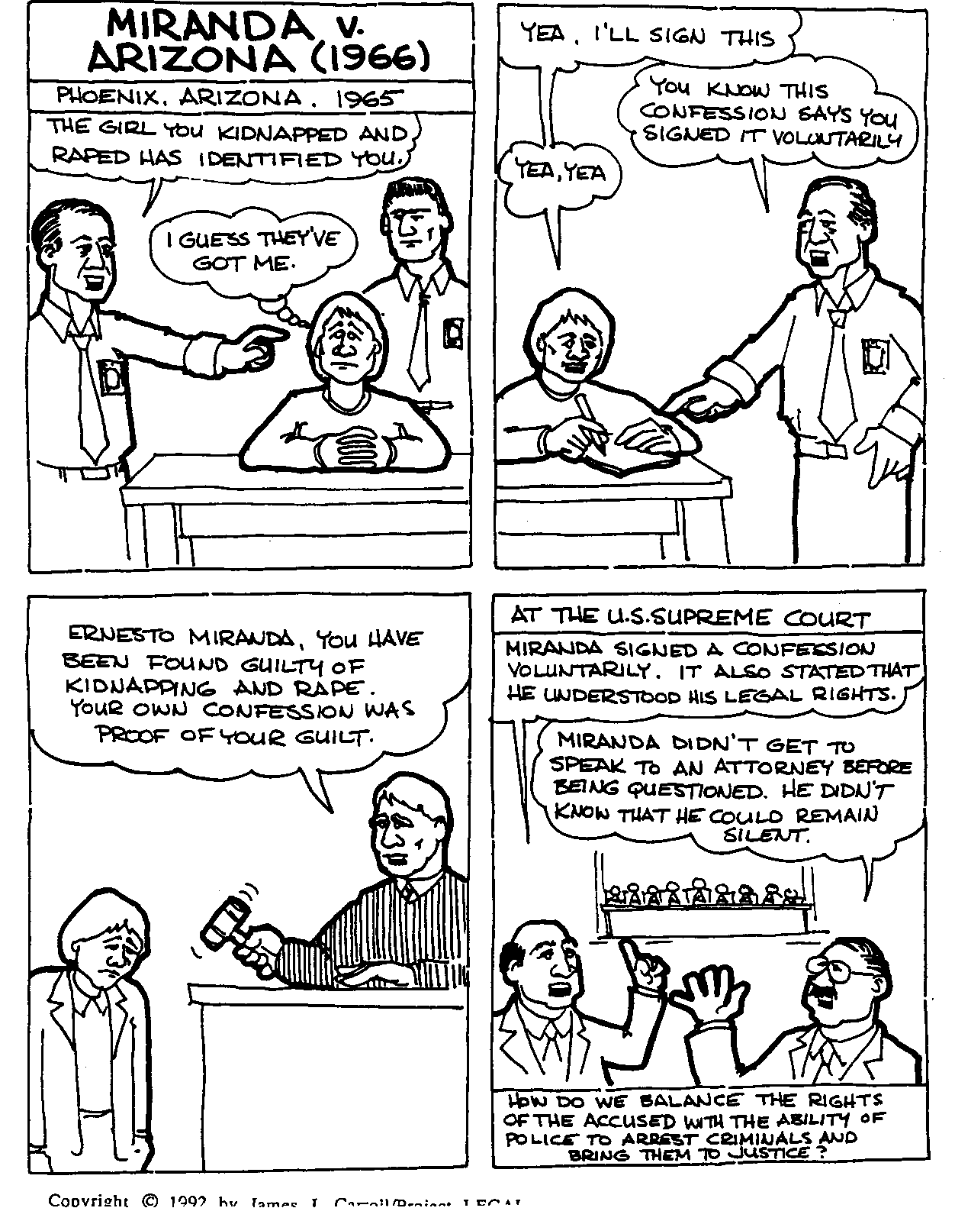

Slide 25
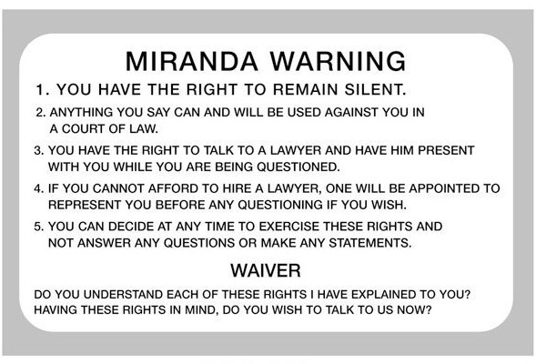

Slide 26
Civil Rights Movement
SNCC vs. SCLC
See your chart
Sit ins occurred segregated lunch counters all across the South
Freedom rides on interstate buses to determine if southern states would enforce laws against segregation in public transportation

Slide 27
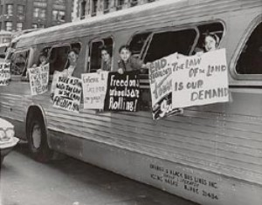
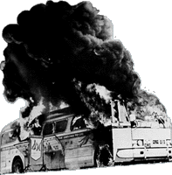
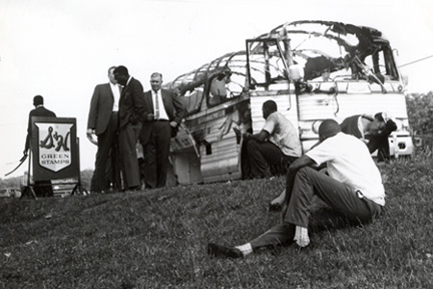

Slide 28
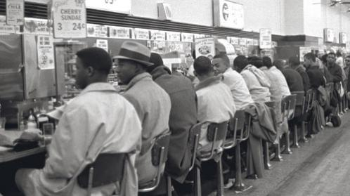

Slide 29
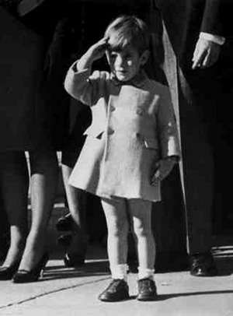
Civil Rights Movement
JFK Assassination, 1963
MLK Jr. Assassination, 1968
riots in over 100 cities across America
Senator Robert Kennedy(President Elect) calms Americans and helps pass the Civil Rights Act of 1968 in MLK’s memory
Robert Kennedy Assassination, 1968
desired for social reform and opposed the Vietnam War
Shot while running for President the same night he won the primaries in California + South Dakota
Democratic National Convention, 1968
Violence and riots erupt on Live TV
Armed police and protesters square off

Slide 30
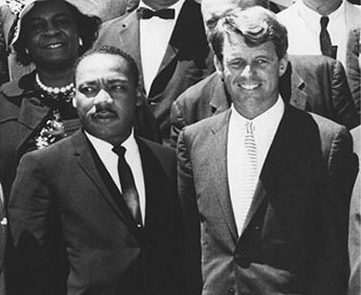
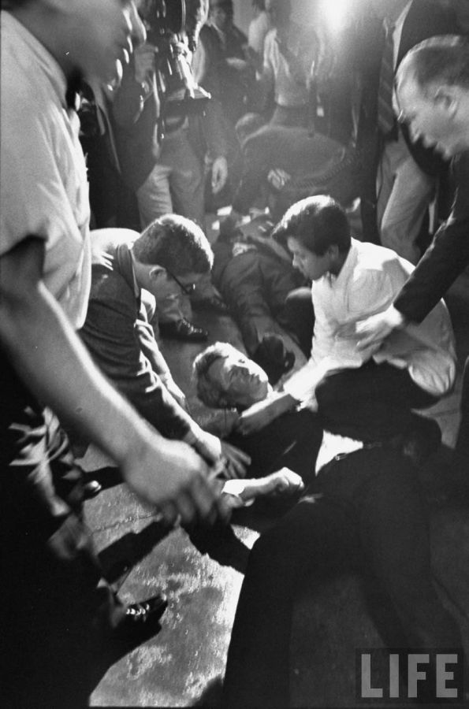
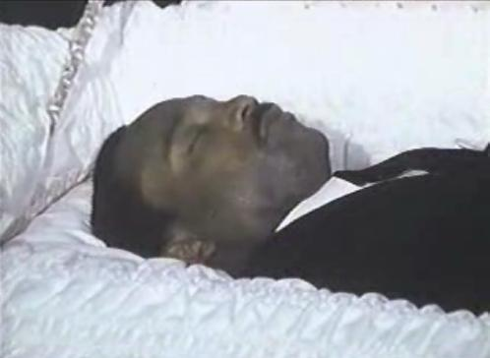

Slide 31
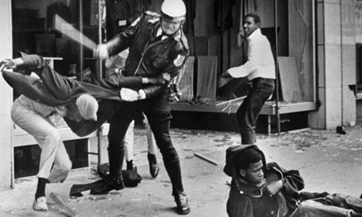
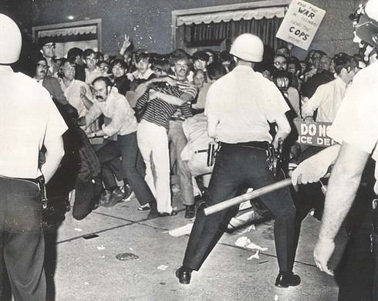
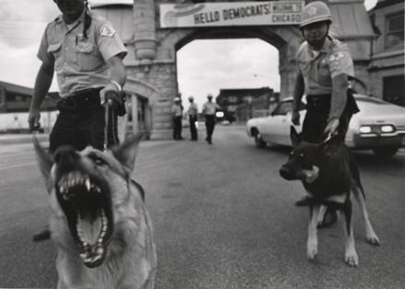
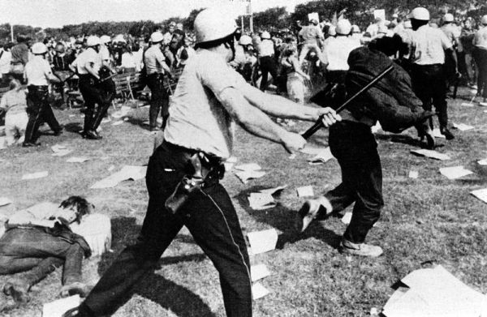

Slide 32
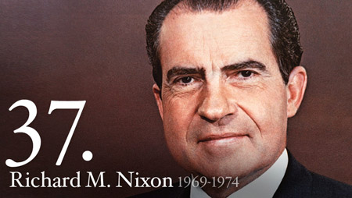

Slide 33
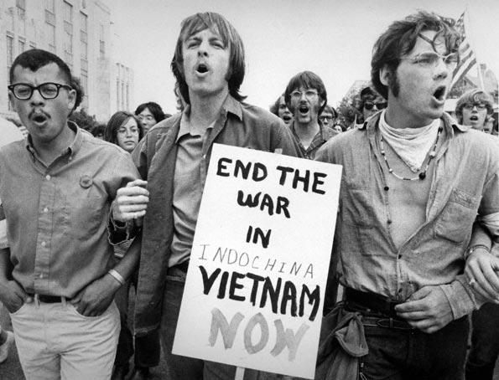
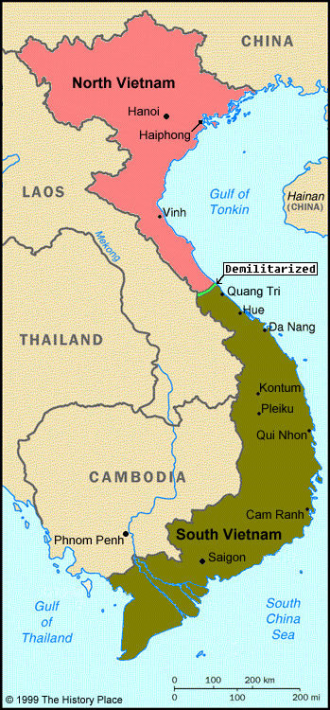
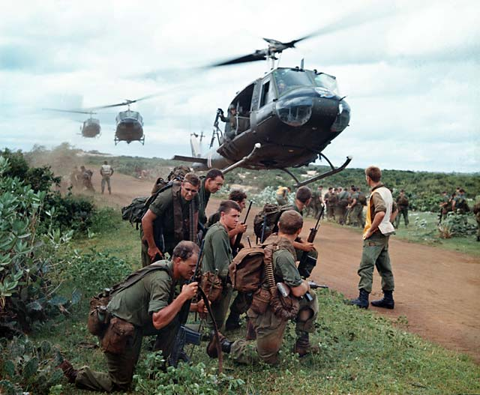
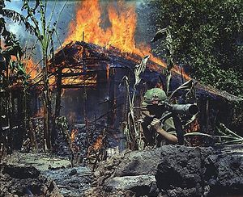

Slide 34
Vietnam Conflict
Ho Chi Minh leads Communists lead rebellion to liberate Vietnam form French control
US govt helps Ngo Dinh Diem stay in power in South Vietnam because he is anti-communist
The Vietcong constantly use guerilla tactics to oppose Diem and the US forces in South Vietnam
The Tonkin Gulf Resolution in 1964, gives the President the power to send troops to Vietnam without a Congressional Declaration of War

Slide 35
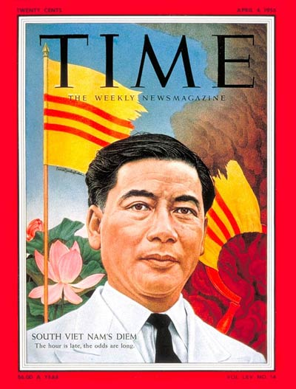
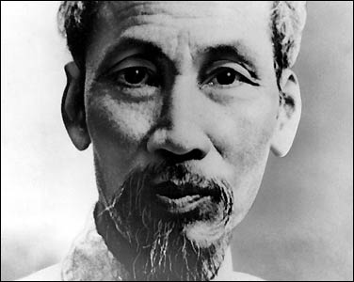

Slide 36
Vietnam Conflict
1965- US Sends troops into Vietnam to fight the Vietcong and the North Vietnamese Army
Most soldiers fighting in Vietnam were drafted into the military against their will
As the number of people drafted grows, so did Americans opposition to the War
1968- Tet Offensive
1973- US sign Peace Treaty and troops leave

Slide 37
Vietnam Conflict
Tet Offensive (1968)
aggressive attack of over 100 South Vietnamese towns,
12 American air bases
U.S. embassy in South Vietnam
Demonstrated a lack of control of the conflict by Americans
Many Americans at home turned against the war and against the Johnson administration, which had claimed the enemy was near defeat.

Slide 38
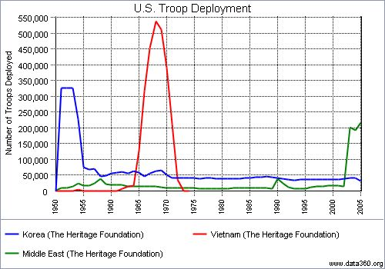

Slide 39
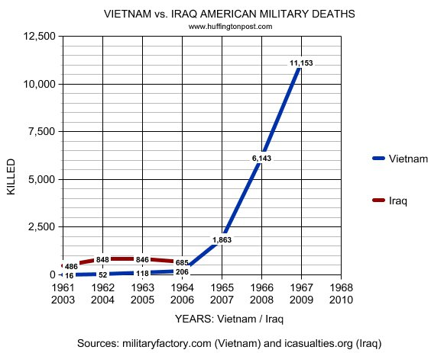

Slide 40
Vietnam Conflict
Anti–Vietnam Movement
Americans against the conflict in Vietnam became more vocal in their opposition as the situation dragged on.
Many antiwar groups started on college campuses to urge the government to end selective service (the draft) and to bring home all American troops from Vietnam.
They used many of the same tactics as groups fighting for civil rights, including sit-ins, marches, and demonstrations.
Some protesters radical, burning their draft cards, going to prison rather than going to Vietnam, and even fleeing to Canada.

Slide 41
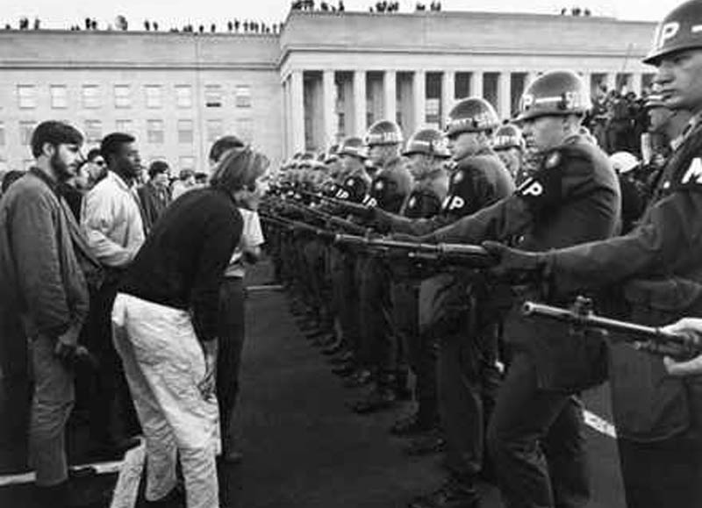
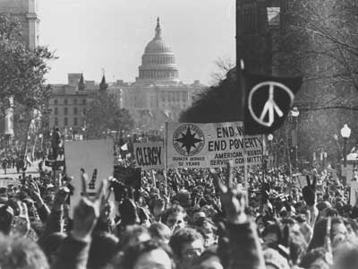
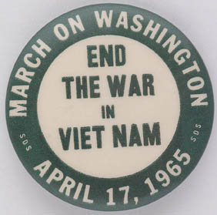

Slide 42
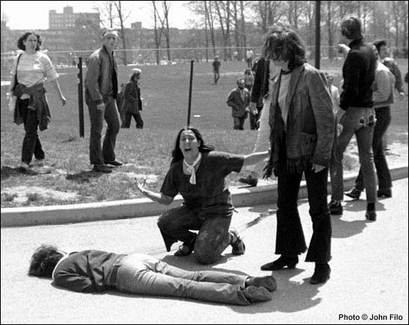
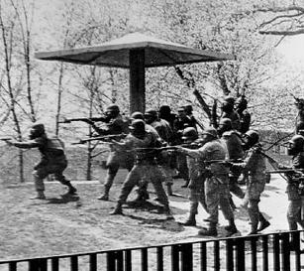
Kent State (university in Ohio)

